Slide 1


Distributed file system
NFS & GFS
SE3331-1 (2023 Fall)
Yubin Xia
IPADS, Shanghai Jiao Tong University
https://www.sjtu.edu.cn
Credits: Rong Chen@IPADS

Slide 2
Large-scale website so-far
Large-scale websites are composed of different distributed systems
  Request processing, data storage
Caching server
Caching server
Caching server
…
Caching
Caching
Caching
Distributed caching
Database server
Database server
CDN
Users
Application #1
generate the page
Database
user, price
…
Database
user, price
Application server
Distributed database
Internet
Load
Balance
Application #2
add the order
File server
File server
File server
File:
image
File:
image
…
File:
image
Application server
…
…
Message queue
Distributed file system

Slide 3
Large-scale website so-far
Large-scale websites are composed of different distributed systems
  Request processing, data storage
  How each system communicates?
Caching server
Caching server
Caching server
…
Caching
Caching
Caching
Distributed caching
Database server
Database server
CDN
Users
Application #1
generate the page
Database
user, price
…
Database
user, price
Application server
Distributed database
Internet
Load
Balance
Application #2
add the order
File server
File server
File server
File:
image
File:
image
…
File:
image
Application server
…
…
Message queue
Distributed file system

Slide 4


Last lecture: Remote Procedure Call (RPC)
Allow a procedure to execute in another address space without coding the details for the remote interaction
RPC History
  Idea goes back in 1976
RPC uses stubs to avoid handling argument encoding/decoding and send/receiving messages, message transports, etc.
How RPC handles failures?
  Depends on the semantic: at-most-once, at-least-once & exactly-once

Slide 5
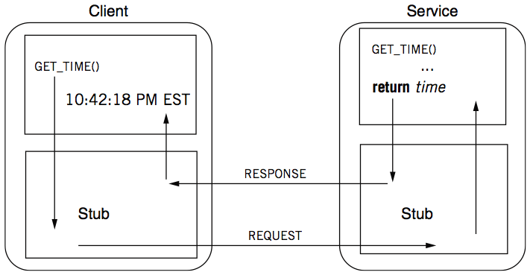
Review: RPC -- a complete calling process

Slide 6

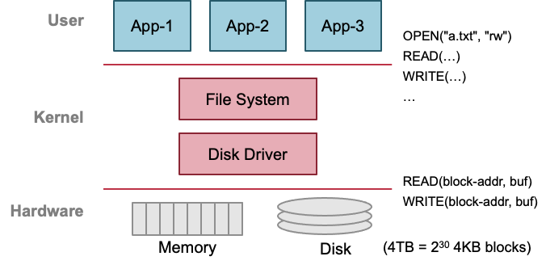
Previous lecture: single-machine file system
Storage as files
Caching server
Caching server
…
Caching server
Caching
Caching
Caching
Distributed caching
Database server
Database server
CDN
Users
Application #1
generate the page
Database
user, price
…
Database
user, price
Application server
Distributed database
Internet
Load
Balance
Application #2
add the order
File server
File server
File server
File:
image
File:
image
…
File:
image
Application server
…
…
Message queue
Distributed file system

Slide 7
With the help of RPC
We can now build distributed file system!

Slide 8
Distributed file system
Key components in distributed systems
  Stores large blob of data, intermediate results, database/KV backends, etc.
Caching server
Caching server
Caching server
…
Caching
Caching
Caching
Distributed caching
Database server
Database server
CDN
Users
Application #1
generate the page
Database
user, price
…
Database
user, price
Application server
Distributed database
Internet
Load
Balance
Application #2
add the order
File server
File server
File server
File:
image
File:
image
…
File:
image
Application server
…
…
Message queue
Distributed file system

Slide 9
Ways for accessing remote files
Many familiar ways, FTP, telnet, …
  Explicit access (knowing it is a distributed file system)
  User-directed connection to access remote resource
There is also transparent approach
  E.g., NFS, GFS, etc.
  Applications access the remote files like a local file

Slide 10
Distributed File Service Types
Upload/Download model
  Read file: copy file from server to client
  Write file: copy file from client to server
Advantage
  Simple
Problem
  Wasteful “what if client needs small pieces?”
  Problematic “what if client does not have enough space?”
  Consistency “what if others modify the same file?”

Slide 11
Distributed File Service Types
Remote access model
  File service provide functional interface with RPC
  (create, delete, read, write, etc.)
Advantage
  Client gets only what’s needed
  Server can manage a consistent view of file system
Problem
  Possible server and network problem (e.g., congestion)
    Servers are accessed for duration of file access
    Same data may be requested repeatedly

Slide 12
NFS with RPC

Slide 13
NFS: Network File System
Design Goals (by Sun, 1980s, designed for workstations)
  Any machine can be a client or a server
  Support diskless workstations
  Support Heterogeneous deployment
    Different HW, OS, underlying file system
  Access transparency
    Use remote access model
  Recovery from failure
    Stateless, UDP, client retries
  High performance
    Use caching and read-ahead

Slide 14
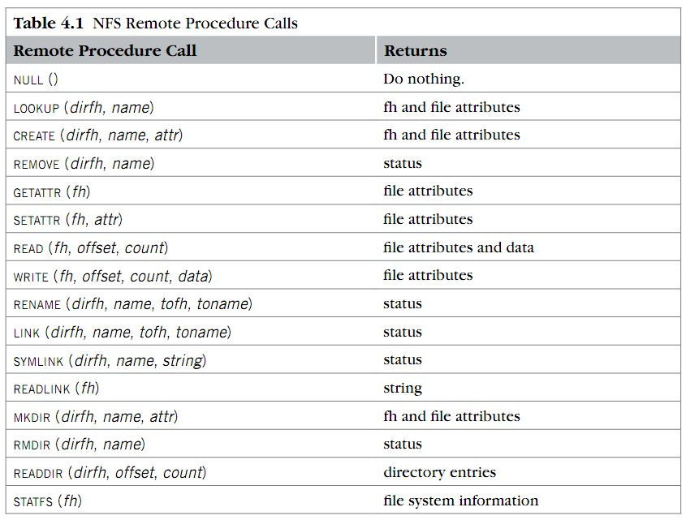
RPC used in NFS
Where is OPEN and CLOSE?

Slide 15
NFS Protocols: Mount
Protocol:
  Request access to exported directory tree
    Requests permission to access contents
  Server returns file handle (fh)
Client: parses pathname
contacts server for file handle
Client: create in-memory VFS inode (vnode) at
mount point internally points to remote files
(client keeps state, not the server)

Slide 16
NFS Protocols: Mount
Static mounting
  mount request contacts server
Server:
add list of shared directories to /etc/exports
Client:
mount 192.168.1.100:/users/paul /home/paul

Slide 17
NFS Protocols: Lookup/READ/WRITRE...
Directory and File Access Protocol:
  Access files and directories (read, mkdir, …)
First, perform a lookup RPC
  Returns file handle and attributes
lookup is not like open
  Establish state on the client only (no information on server)
  Call the NFS lookup function
The handle passed as a parameter for other file access function
  e.g., read(handle, offset, count)

Slide 18
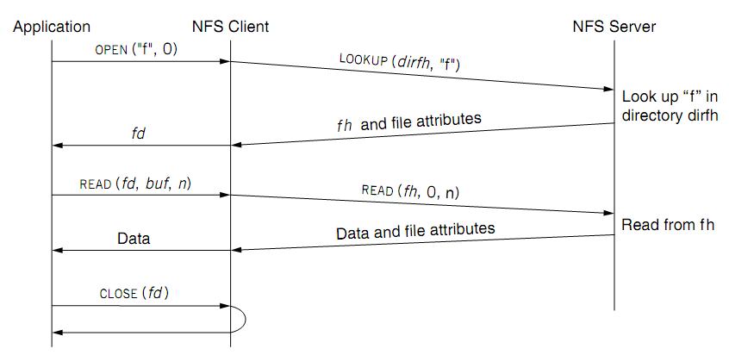
Read a file of NFS
fd <--> fh (file handler)
No state after open()

Slide 19
NFS Protocols: Lookup/READ/WRITRE...
NFS has 16 functions (version 2)
null
lookup
link
symlink
readlink
getattr
setattr
create
remove
rename
statfs
mkdir
rmdir
readdir
read
write

Slide 20
File Handler for a Client
File handler contains three parts
  File system identifier: for server to identify the file system
  inode number: for server to locate the file
  Generation number: for server to maintain consistency of a file
Can still work across server failures
  E.g., server reboot
Q: Why not put path name in the handle?

Slide 21
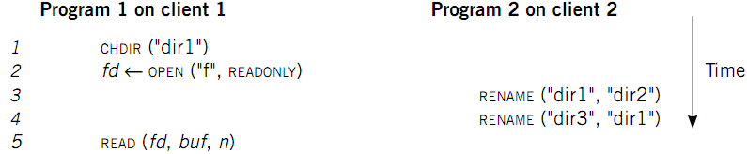
Case 1: Rename After Open
UNIX Spec:
  Program 1 should read "dir2/f"
  NFS should keep the spec

Slide 22
Stateless on NFS server
Stateless on NFS server
  Each RPC contains all the information
Q: What about states like file cursor?
  Client maintains the states, including the file cursor
Client can repeat a request until it receives a reply (at least once)
  Server may execute the same request twice
  Solution: each RPC is tagged with a transaction number, and server maintains some "soft" state: reply cache
  Q: What if the server fails between two same requests?
Notes:
What about the case of "delete-after-open"?

Slide 23
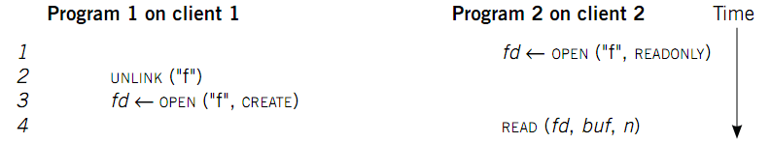
Case 2: Delete After Open
UNIX spec:
  On local FS, program 2 will read the old file
How to avoid program 2 reading new file?
  Generation number
  "stale file handler"
Not the same as UNIX spec! It's a tradeoff...

Slide 24
NFS performance
Usually slower than local
  Question: depends on what?
Optimization: caching at client
  Goal: reduce number of remote ops
  Caching: read, readlink, getattr, lookup, readdir
      Cache file data at client (buffer cache)
      Cache file attribute information at client
      Cache pathname bindings for faster lookup
Server side
  Caching is “automatic” via buffer cache
  All NFS writes are write-through to disk
  File server performance & network speed

Slide 25
Cache on the Client
NFS client maintains various caches
  Stores a vnode for every open file
    Know the file handles
  Recently used vnodes, attributes, recently used blocks, mapping from path name to vnode
Cache benefits
  Reduce latency
  Less RPC, reduce load on server
Cache coherence is needed

Slide 26
Problem: cache coherence
Type-1: Read/write coherence
  On local file system, READ gets newest data
  On NFS, client has cache
  NFS could guarantee read/write coherence for every operation, or just for certain operation
Type-2: Close-to-open consistency
  Higher data rate
  GETATTR when OPEN, to get last modification time
  Compare the time with its cache
  When CLOSE, send cached writes to the server
Notes:
Mixed blocks, old and new

Slide 27
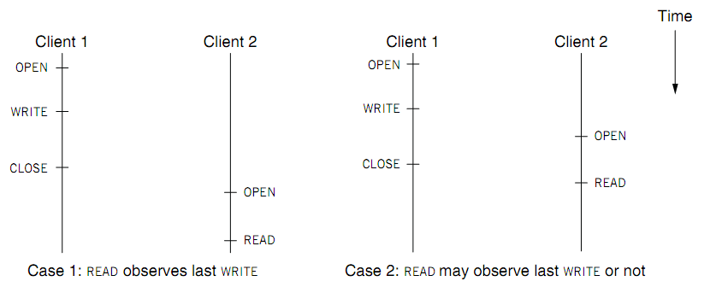
Coherence
Two cases of close-to-open consistency
More contents of consistency in later lectures

Slide 28
VFS: Extend the inode-based FS to support NFS
Vnode
  Abstract whether a file or directory is local or remote
  In volatile memory (why?)
  Support several different local file system
  Where should vnode layer be inserted?
Vnode API
  Same as we learnt: OPEN, READ, WRITE, CLOSE…
  Code of fd_table, current dir, file name lookup, can be moved up to the file system call layer

Slide 29
Validation
Inconsistencies may arise in NFS
Resolve inconsistencies with validation
Both server and client save timestamp of files
When file opened or server contacted for new
  Compare last modification time
  If remote is more recent, invalidate cached data
Always invalidate data after some time
  open files (3 sec), directories (30 sec)
If data block is modified, it is:
  Marked dirty, then flushed on file close

Slide 30
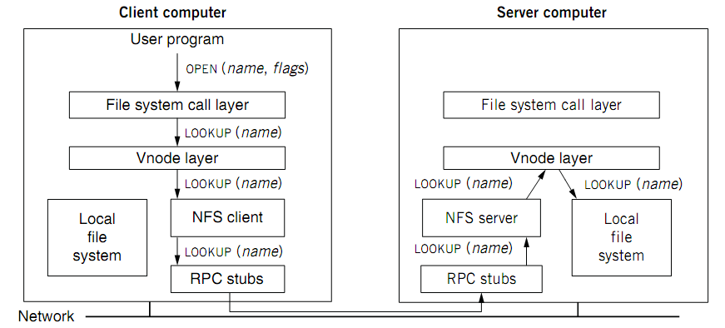
VFS: Extend the inode-based FS to support NFS

Slide 31
Accessing Remote Files
Implement the client module as a FS under VFS
System Call Interface
VFS
Sockets
ext4
procfs
RemoteFS
Network Protocols
Network
NIC
Abstracted with the RPC interface
& client-side cache

Slide 32
Improving Read Performance
Transfer data in large chunks
  8KB default
Read-ahead
  Optimize for sequential file access
  Send requests to read disk blocks before they are requested by the applications

Slide 33
NFS is continuously improving
Version 3
Version 4
User-level lock manager
NVRAM support
Adjust RPC retries dynamically
Client-side disk caching
Support 64-bit file sizes
TCP support and large-block transfers
Commit operation
…
More state: control of caching, notify of file changes
Server export a single name space (pseudo file system)
Compound RPC support
Extended attribute and ACL
Negotiate security mechanism on mount
…

Slide 34
Reference Materials
RFC 1831: RPC Specification
  http://www.ietf.org/rfc/rfc1831.txt?number=1831
RFC 1832: XDR Specification
  http://www.ietf.org/rfc/rfc1832.txt?number=1832

Slide 35
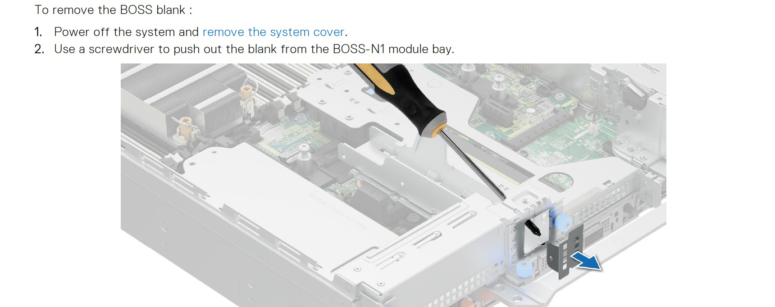
Drawback of NFS
Capacity
  Can only disks on a single server, which has a limited capacity to insert disks

Slide 36
Drawback of NFS
Capacity
  Can only disks on a single server, which has a limited capacity
2. Reliability
  If the server crashes, the remote files are unavailable
3. Performance
  The file performance is limited to a single file (and a single network bandwidth)

Slide 37
Observation: plenty of available servers in a datacenter
Plenty of machines in a datacenter
  E.g., much cheaper than a high-end server
Idea: utilis multiple machines to form a single, large distributed file system
  We can leverage the aggregated capacity of all the machines!
Naïve solution: do manual partitioning
  User decides which files / directories are stored on which server
  Not so good: dates back to the FTP case ☺

Slide 38
Design goal: transparent remote file accesses
We don’t want the developers to manage which file store on which server
  It is difficult to the developers
  Also, does not support existing applications
But, it means that we cannot reuse the inode-based filesystem implementations
  Nevertheless, the overall principles are the same, e.g., we still needs things like block layer, inode layer, etc.
We will see many challenges faced by distributed systems during our journal ☺

Slide 39

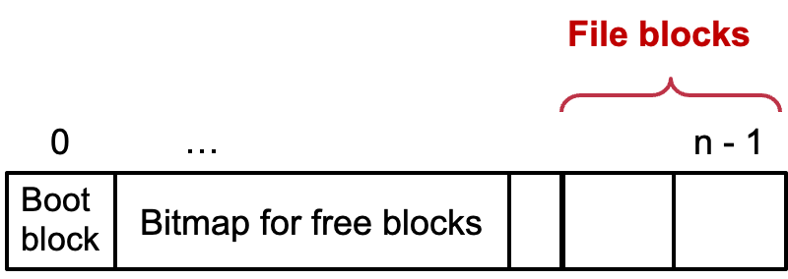
Step #1: Distributed block layer
File blocks
0
1
…
n - 1
Boot
block
Super
block
Bitmap for free blocks
…
File blocks
0
…
n - 1
Boot
block
Bitmap for free blocks

Slide 40
Step #1: Distributed block layer
File
(inode)
Block num
Disk
Block
Q1. How to access the block in a distributed setting?
  Simple, we can extend the block_id to <mac_id, block_id>
Q2. Second, how can a client know which machine has a free block?
  Sol#1. select a random server; if it has free block, then we are done; if not, retry until we can find one.
  Sol#2. use a master server to record the free blocks at each machine, and all the block allocation & deallocation go to the master
Master
…
File system metadata: free blocks
Notes:
Sol#1 is not so good: what if we want allocate many blocks? Multiple RTTs

Slide 41
L2: File Layer: do we need a redesign?
File
(inode)
Block num
Disk
Block
Recall: Given an inode, can map a block index number (of a file) to a block number (of a disk)
  Index number: e.g., the 3rd block of a file is number 78
No need for now for now for functionality, since we can access the blocks
  With our previous designed distributed layer
There are some other issues, e.g., performance, reliability, consistency, etc.
  We will back to these example later

Slide 42
L3: Distributed inode Number Layer
Inode num
File
(inode)
Block num
Disk
Block
Mapping: inode number -> inode
inode table: at a fixed location on storage
  inode number is the index of inode table
  Track which inode number are in use, e.g. free list, a field in inode
Distributed inode number layer: store the inode table at the master!
Inode table
Master
…
File system metadata: free blocks + inode table

Slide 43
L4: File Name Layer
File
name
Inode num
File
(inode)
Block num
Disk
Block
File name
  Hide metadata of file management
  Files and I/O devices
Mapping
  Mapping table is saved in directory
  Default context: current working directory
    Context reference is an inode number
    The current working directory is also a file
  Question
  Do we need to extend it to a distributed setup? So far, so good!
struct inode
integer block_nums[N]
integer size
integer type
Overview of inode content
File name | inode num
helloworld.txt | 12
cse2021.md | 73

Slide 44

Put the distributed file layers so far together
Example: lookup (simplified)
Local lookup
<0,12>, <1,64>
Read
File system metadata: free blocks + inode table
Filename,
directory inode
<0,12>
Master
Read
<1,64>

Slide 45
Put the distributed file layers so far together
Example: write (simplified, assuming no blocks )
<0,12>, <1,64>
File system metadata: free blocks + inode table
Inode, offset, size
Write
<0,12>
Master
write
<1,64>

Slide 46
L5: Path Name Layer
File
name
Inode num
File
(inode)
Block num
Disk
Block
Path name
Hierarchy of directories and files
  Structured naming: E.g. "projects/paper"
Context: the working directory dir
If we have the lookup, then we can also do the path lookup ☺
procedure PATH_TO_INODE_NUMBER(string path, integer dir)-> integer
if PLAIN_NAME(path)return NAME_TO_INODE_NUMBER(path,dir)
else
dir <- LOOKUP(FIRST(path), dir)
path <- REST(path)
return PATH_TO_INODE_NUMBER(path,dir)

Slide 47
Issues of our naïve design so far
Performance
  E.g., path lookup is slow due to multiple RTTs
  Though we can use cache, like we have done in NFS ☺
  But, what about data in a file? If the read is large, it uses many blocks, so many servers needed to be communicated
Reliability
  E.g., what if the master fails?
  E.g., what if some servers that store the blocks fail?
Correctness
  If a failure happens, the overall system states will be corrupted!

Slide 48

Correctness broken under failure: example
Example: write (simplified, assuming no blocks allocation)
<0,50>, <1,64>
File system metadata: free blocks + inode table
Inode, offset, size
Write
<0,12>
Master
write
<1,64>
Notes:
Not a significant problem

Slide 49
Correctness broken under failure: example
Example: rename (simplified with only reference counters operations)
12
Ref +=1
File system metadata: free blocks + inode table
Write
<0,12>
Master
write
<1,64>
64
Ref -=1
Notes:
Fatal issues may happen

Slide 50
Failure is a subtle issue & can even happens under in inode-base filesystem
We will talk about the issues in later lectures

Slide 51
We need more “weapons” to cope w/ the above issues
Performance
  E.g., path lookup is slow due to multiple RTTs
  Though we can use cache, like we have done in NFS ☺
Reliability => we need data replication
  E.g., what if the master fails?
  E.g., what if some servers that store the blocks fail?
Correctness => we need to define what is correct & how to achieve so ☺
  If a failure happens, the overall system states will be corrupted!

Slide 52
Case study: GFS
The Google File System
  Sanjay Ghemawat, “The Google File System”. SOSP, 2003
Notes:
Based on our previous illustration, but make some extension based on Google’s internal need, or made some trade-offs

Slide 53
GFS design goals
Scalable distributed file system
  E.g., Can NFS stores a very large file?
Designed for large data-intensive applications
  Essential for distributed computing frameworks, e.g., MapReduce
Fault-tolerant; runs on commodity hardware
  E.g., what if a server crashes, in the case of NFS?
Delivers high performance to a large number of clients

Slide 54
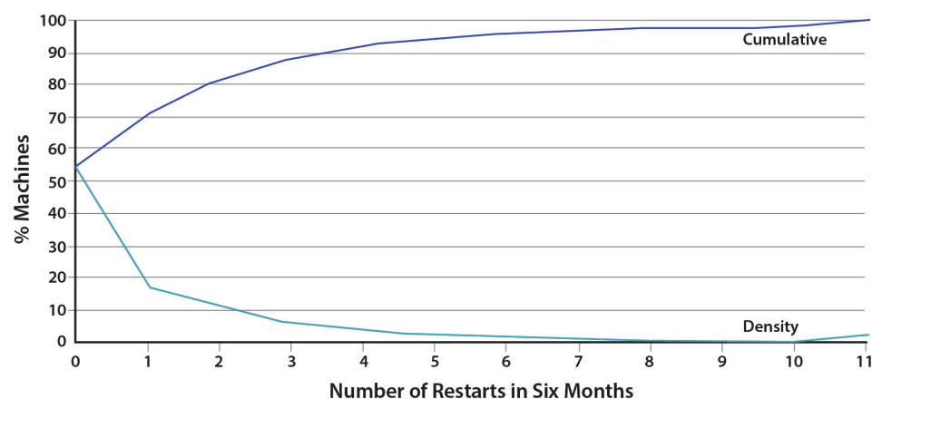
Design Assumptions
Assumptions for conventional file systems don’t work
  E.g., “most files are small”, “short lifetimes”
Component failures are the norm, not an exception
  File system = thousands of storage machines
  Some % not working at any given time (recall from lecture2)
Machine failures at Google. Source: An Introduction to the Design of Warehouse-Scale Machines

Slide 55
Design Assumptions: environments
Assumptions for conventional file systems don’t work
  E.g., “most files are small”, “short lifetimes”
Component failures are the norm, not an exception
  File system = thousands of storage machines
  Some % not working at any given time (recall from lecture2)
Files are huge: n-GB/TB files are the norm, e.g., large web index
  I/O ops and block size choices are affected

Slide 56
More Design Assumptions: File Access
Most files are appended, not overwritten (why? E.g., add new web pages to the Google’s global store)
  Random writes within a file are rare
    Means we need to provide efficient appends
Workload is mostly:
  mostly reads: large streaming reads;
    Once created, files are mostly read; often sequential (e.g., read a previous archived page)
We should
designing the FS API with the design of apps benefits the system

Slide 57
GFS interface
GFS does not have a standard OS-level API
  No POSIX API
  No kernel/VFS implementation
  It provides user-level API
Operations
  Basic ops: create/delete/open/close/read/write
  Additional ops: snapshot/append
  Not supported ops: link, symlink, rename
  Why not rename? As I illustrated before, hard to ensure consistency under failures (no mature distributed TX---see later lectures---at that time)
Notes:
The assumptions are just listed in the paper, lack a detailed descriptions

Slide 58
GFS architecture
A GFS cluster = 1 Master (Distributed inode layer) + N Chunkservers (Distributed blocks layer + replication)
chunk
server
chunk
server
chunk
server
Master
. . .
chunk
server
File system metadata
Maps files to chunks
chunk
server
Data Storage: fixed-size chunks
Chunks replicated on several system

Slide 59
GFS files
A File is made of 64MB chunks, possibly spawn multiple machines
That are replicated for fault-tolerance
Chunks live on chunkservers
chunkserver
chunkserver
chunkserver
Used for fault tolerance, talked later
checkpoint
image
operation
log
The master manages
the file system namespace
master
In-memory FS metadata

Slide 60
Chunks (Blocks) and Chunkservers
Chunk size = 64 MB (default)
  32-bit checksum with each chunk
Chunk handle
  Globally unique 64-bit number
  Assigned by the master when creation
Chunks are stored on local disk as Linux files (aka. file system overlay)
Each chunk is replicated on multiple nodes
  Three replicas (default)
  More replicas for popular files to avoid hotspots

Slide 61
Why Large Chunks?
Default chunks size = 64MB
  Compare to Linux ext4 block size: 4KB~1MB
Benefits:
  Reduce the need for frequent communication with master for chunk location info
  Makes it feasible to keep a TCP connection open for an extended time
    Establishing a TCP connect can be costly (two-way handshake, see later lectures)
  Master stores all metadata in memory

Slide 62
GFS Master
Maintains all file system metadata
  Access control info, filename to chunks mappings, current locations of chunks
Manages
  Chunk leases (locks), garbage collection, chunk migration (not the focus of this lecture)
Master replicates its data for fault-tolerance
  A large topic also not the focus of today’s lecture

Slide 63
Questions: differences from our naïve filesystem?
Master stores current locations of chunks (blocks)
  Unlike naïve distributed file, which store the locations in the inode block
  Why? For performance
Master replicates its data for fault-tolerance
  Our previous design does not replicate the data

Slide 64
GFS uses one master, why? Make the design simple
All metadata stored in master’s memory
  Super-fast access
Name-to-chunk maps (e.g., using an in-memory tree)
  Stored in memory
  Also persist in an operation log on the disk (talk about in later chapters)
Don’t store chunk location persistently
  This is queried from all the chunkservers at startup
  Can keep up-to-date: master controls all the management
  Benefits: simpler for consistency management

Slide 65
Client-GFS interaction model
GFS client code linked into each app
  No OS-level API
  Interacts with master for metadata-related ops
  Interacts directly with chunkservers for data
    Master is not a point of congestion
No caching: neither clients nor chunkservers cache data
  Except for the system buffer cache
Clients cache metadata
  e.g., location of a file’s chunks
Notes:
Why no caching? “Client caches offer little benefit because most applications stream through huge files or have working sets too large to be cached.”

Slide 66
Reading a file in GFS (very similar to the naïve DFS)
Reading a file is simple in GFS
1. Contact the master
2. Get file’s metadata: chunk handles
3. Get the location of each of the chunk handles
  Multiple replicated chunkservers per chunk
4. Contact any available chunkserver for chunk

Slide 67
Writing a File in GFS (More complicated due to replication)
Less frequent than reading
  But is more complex, because we need to deal with the consistency issues
  GFS adopts a relaxed consistency model (see later lectures)
  E.g, may have inconsistency state, but work well for their apps
  Benefits: simple & efficient to implement
Master grants a chunk lease to one of the replicas
  This replica will be the primary chunkserver
    The only one that can modify the chunk
  Primary can request extensions (of lease), if needed
    Master increases the chunk version number and informs replicas

Slide 68
Writing a File in GFS: Two-phases
Phase 1: send data
Deliver data but don’t write to the file
  A client is given a list of replicas
    Identifying the primary and secondaries
  Client writes to the closest replica
    Pipeline forwarding
  Chunkservers store this data in a cache (in memory)
Client
App
chunkserver
1
chunkserver
2
chunkserver
3
Notes:
Why two phases? Primary should guarantee the same order for applying chunks.

Slide 69
Writing a File in GFS: Two-phases
Phase 2: write data
Add the data to the file (commit)
  Client waits for replicas’ ack of receiving data
  Send a write request to the primary
  The primary is responsible for serialization of writes (applying then forwarding)
  Once all acks have been received
  → The primary sends ack the client
secondary
chunkserver
Client
App
Primary
chunkserver
secondary
chunkserver

Slide 70
Writing a File in GFS: Two-phases
Data flow (phase 1) is different from control flow (phase 2)
Data flow
  Client → chunkserver → chunkserver → ...
  Order does not matter
Control flow
  Client → primary → all secondaries
  Order maintained (also for concurrent writes from multiple clients)
Chunk version numbers are used to detect if any replica has stale data
  Is maintained by the primary chunkserver
  If a replica has stale data, it shall be replaced

Slide 71
Naming in GFS: simple flat naming
No per-directory data structure like most file systems
  E.g., directory file contains names of all files in the directory
No aliases (i.e., no hard or symbolic links)
Namespace is a single lookup table
  Maps pathnames to metadata

Slide 72
Summary: GFS in Google cluster
Google cluster environment
  Core services: GFS + cluster scheduling system
  Typically, 100s to 1000s of active jobs
  200+ clusters, many with 1000s of machines
  Pools of 1000s of clients
  4+ PB filesystems, 40GB/s read/write loads
Job-1
Job-2
Job-3
Chunk
Server
Scheduling
Slave
GFS
Master
File system
Master
. . .
Linux
Scheduling
Master
Job Scheduler
Commodity Hardware

Slide 73











HDFS: another popular (open-source) DFS
Hadoop Distributed FS
Primary storage system for Hadoop apps
A framework that allows for the distributed processing of large data sets across clusters of computers

Slide 74
Design Goals & Assumptions of HDFS
HDFS is an open source (Apache) implementation inspired by GFS design
Similar goals as GFS
  Run on commodity hardware
  Highly fault tolerant
  High throughput & large-scale deployments
  …

Slide 75
Recall GFS files
A File is made of 64MB chunks, possibly spawn multiple machines
That are replicated for fault-tolerance
Chunks live on chunkservers
chunkserver
chunkserver
chunkserver
checkpoint
image
operation
log
The master manages
the file system metadata
master
In-memory FS metadata

Slide 76
HDFS files
A File is made of 64MB blocks, possibly spawn multiple machines
That are replicated for fault-tolerance
Blocks live on DataNodes
DataNode
DataNode
DataNode
FSImage
EditLog
NameNode
The NameNode manages
the file system metadata
In-memory FS metadata

Slide 77
Summary
Designing distributed file system (DFS) is not simply
  Single-node file system + RPC
Many design choices for performance, consistency model & failure handling
  Interface
  Caching
  Access model
Two case studies
  NFS: transparent access files on a remote server
  GFS: highly-scalable & fault-tolerant DFS optimized for Google’s workload

Slide 78
GFS or NFS are not Perfect
NFS
  Can not scale
  Is not fault-tolerant
  But is well-enough for many workloads, e.g., sharing the data for experiments in our lab ☺
GFS
  Relaxed consistency model: the results of concurrent mutations are undefined
  Single-node master: single point of failures (though next-generation of GFS refines this, with more advanced techniques developed later)
  Work well in Google’s datacenter workloads

Slide 79
GFS or NFS are not Perfect
NFS
  Can not scale
  Is not fault-tolerant
  But is well-enough for many workloads, e.g., sharing the data for experiments in the lab
GFS
  Relaxed consistency model: the results of concurrent mutations are undefined
  Single-node master: single point of failures (though next-generation of GFS refines this)
  Work well in Google’s datacenter workloads
We will see system principles to cope with them in future lectures.
For other workloads (e.g., Database) may not sufficient.

